Slide 1

Урок вот-вот начнется.
Приготовься, сейчас будет что-то новенькое!

Slide 2


AWS
Basic Concepts

Slide 3

Services Road Map

Slide 4

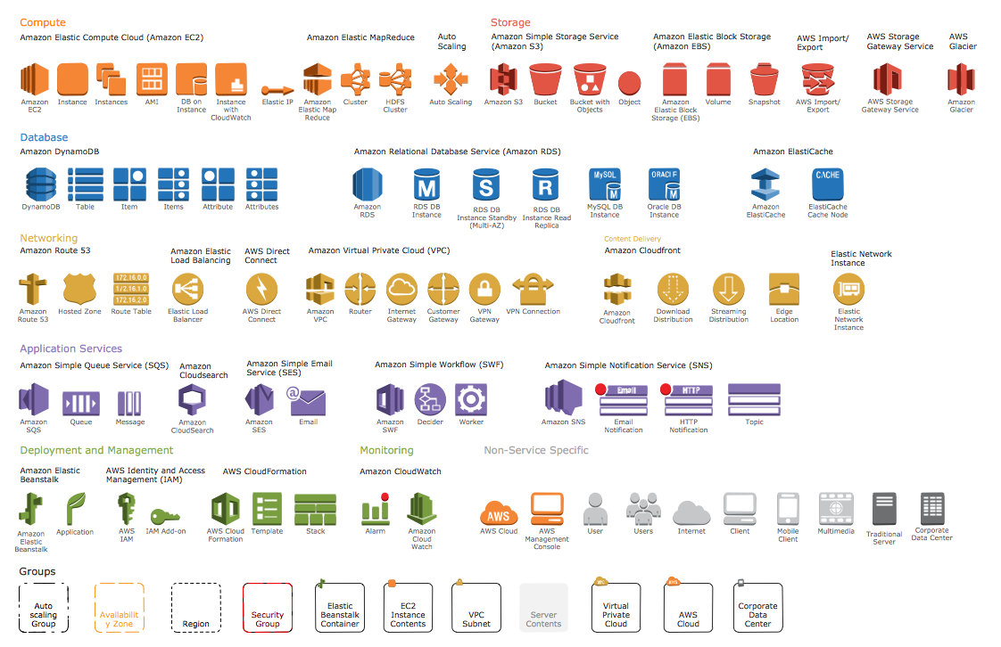

Slide 5

Compute Services

Slide 6
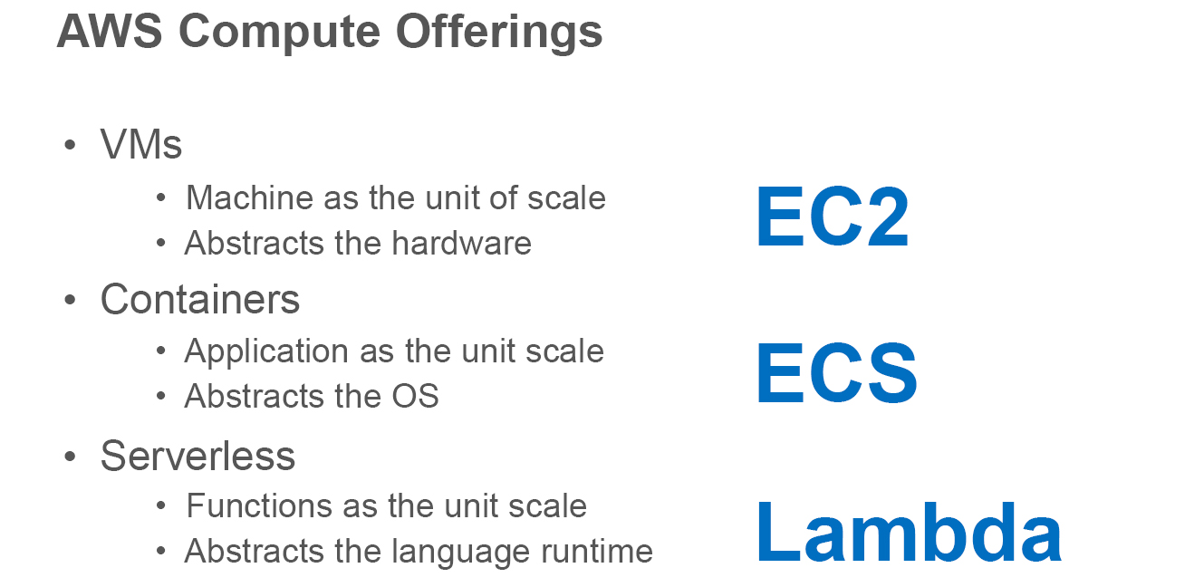
Compute Services

Slide 7
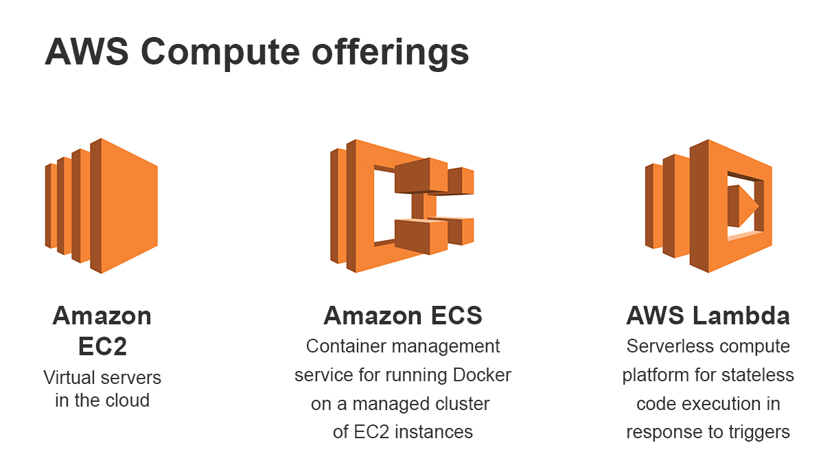
Compute Services

Slide 8
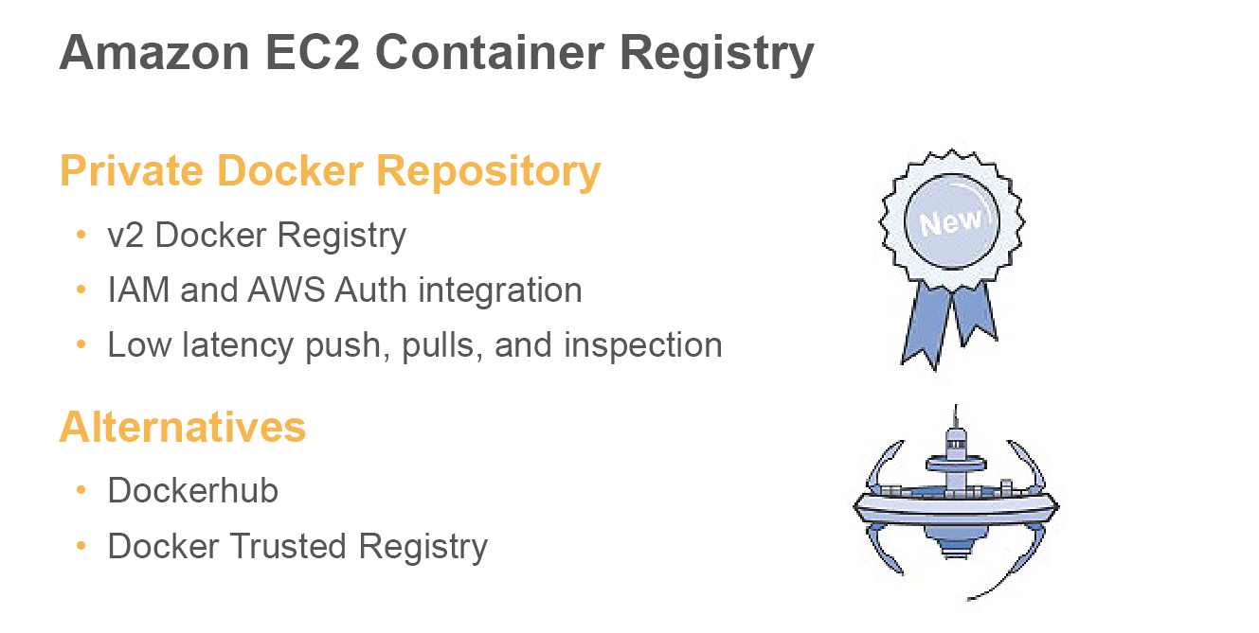
Compute Services

Slide 9

Storage

Slide 10

Storage

Slide 11
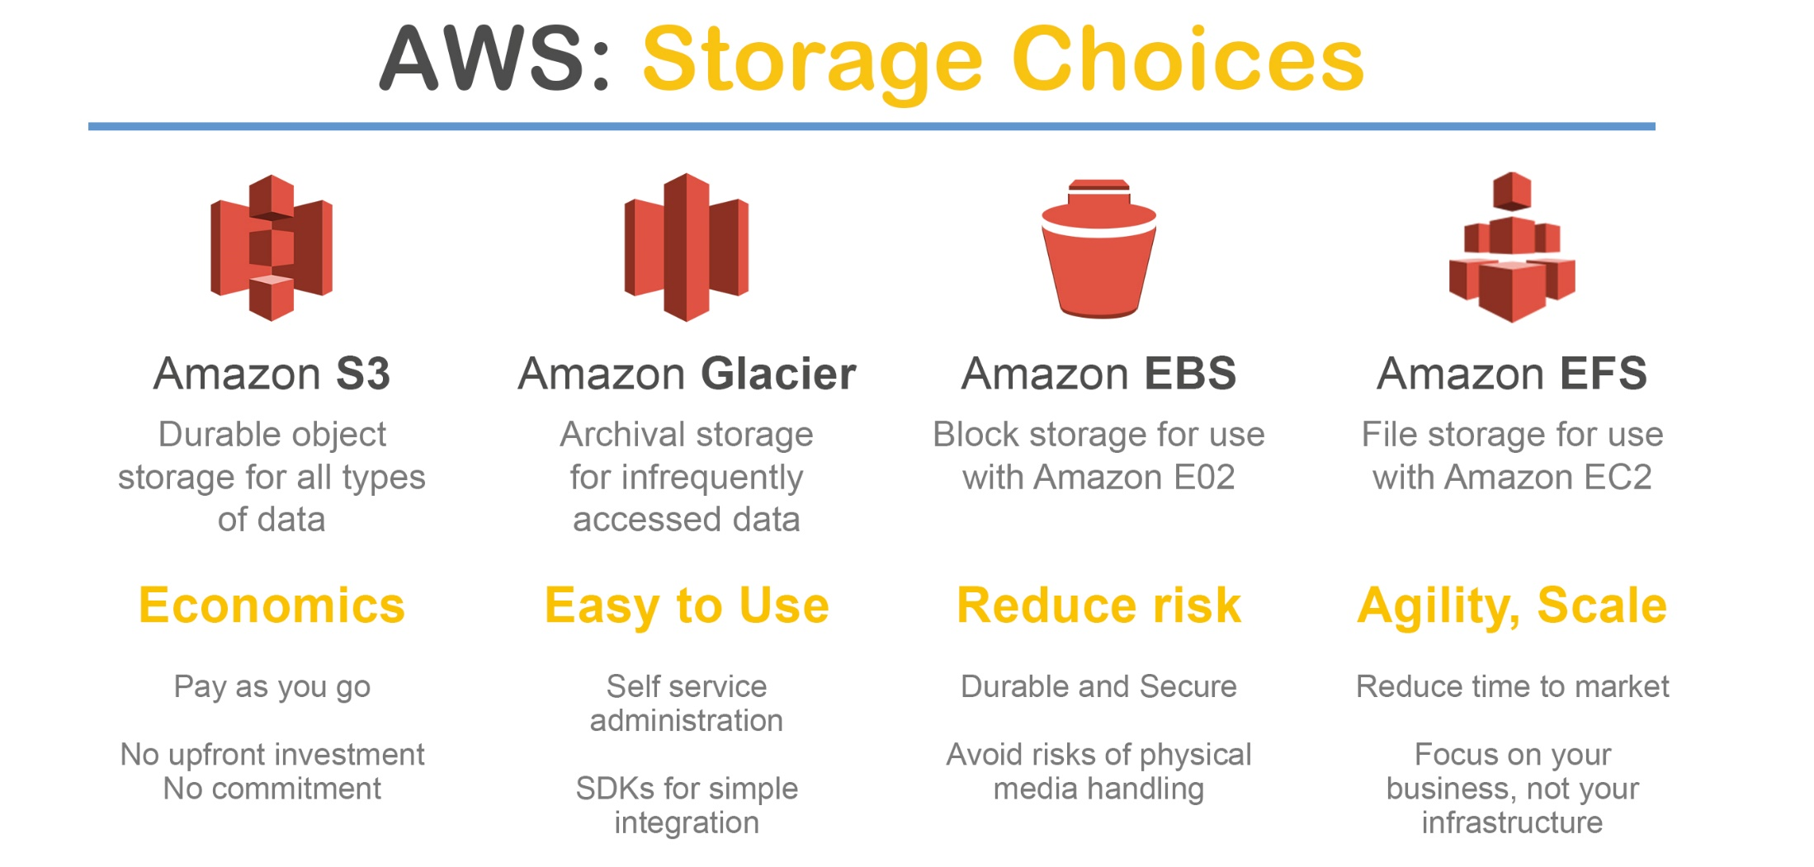
Storage

Slide 12

Databases

Slide 13
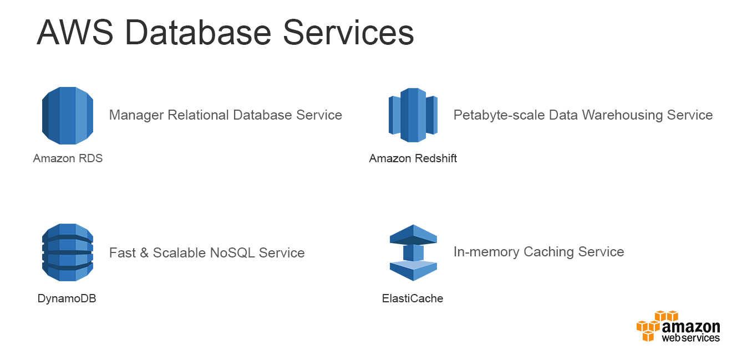
Databases

Slide 14
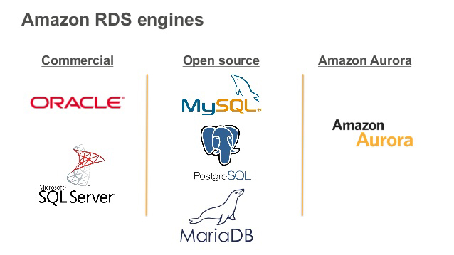
Databases

Slide 15
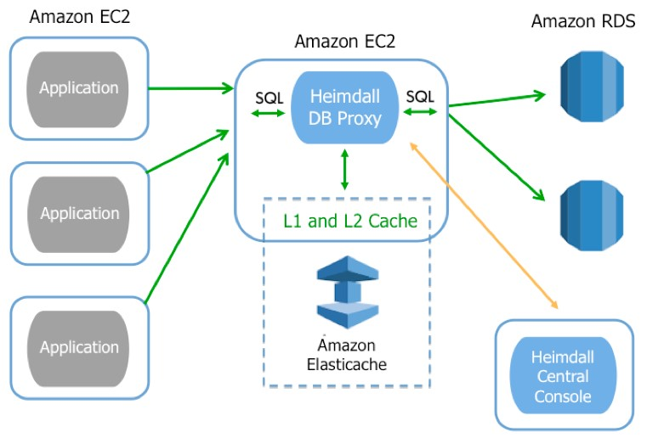
Databases

Slide 16
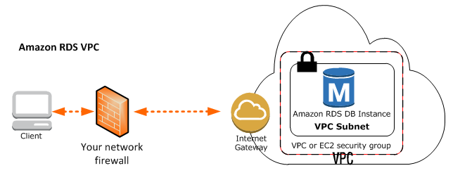
Databases

Slide 17

Networking

Slide 18

Networking

Slide 19
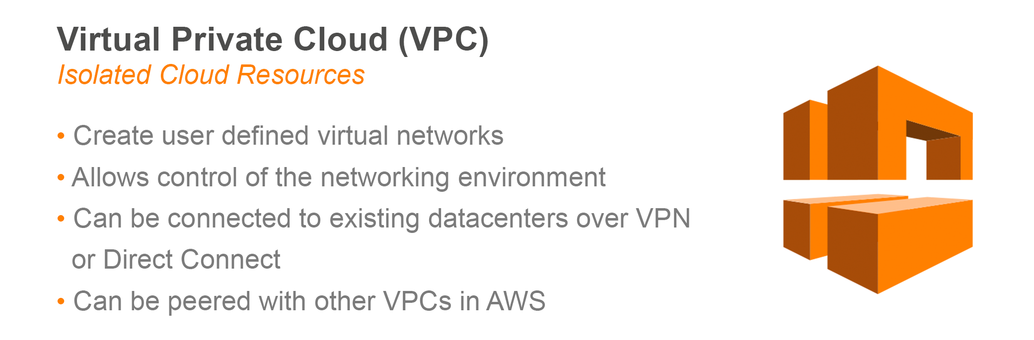
Networking

Slide 20
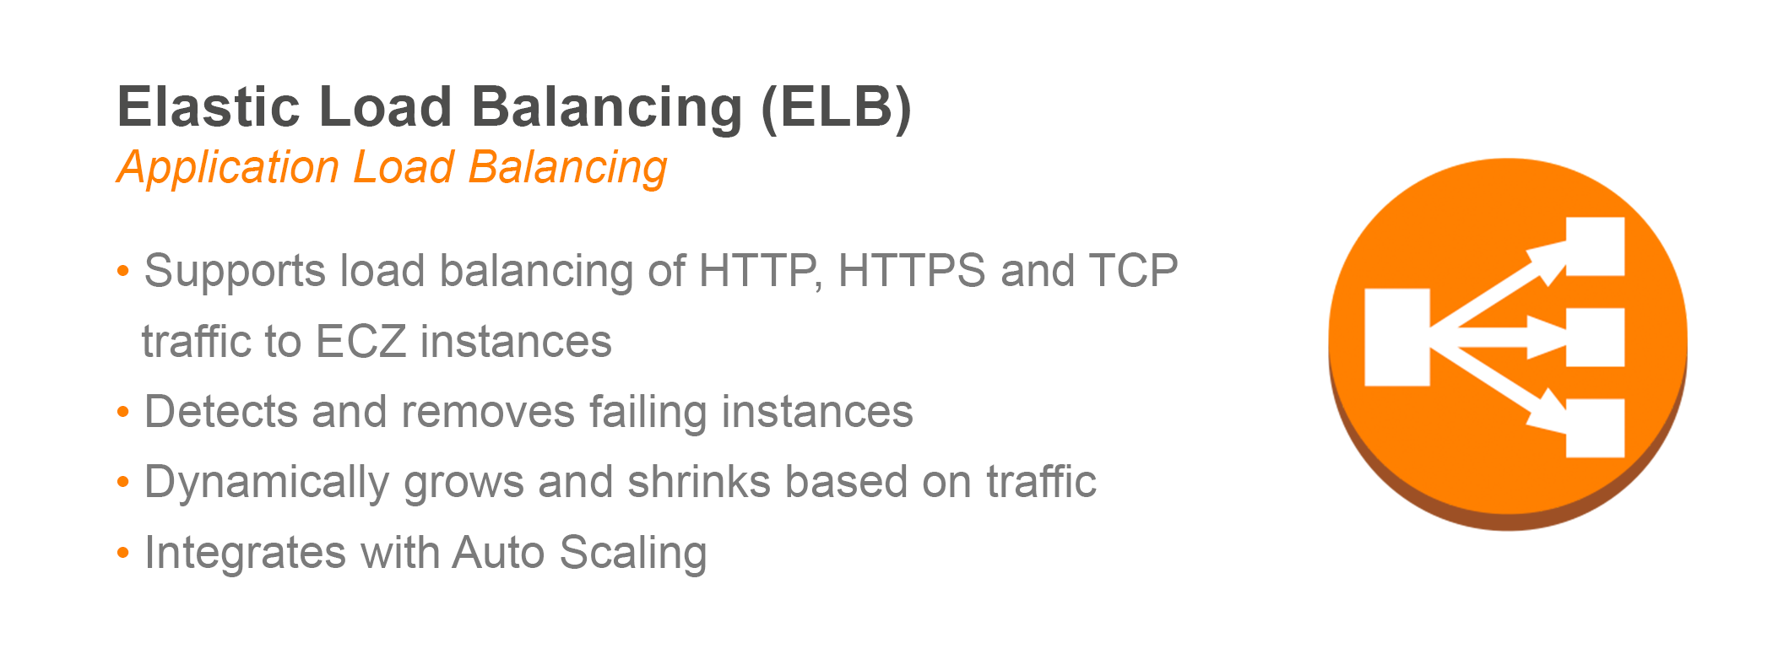
Networking

Slide 21
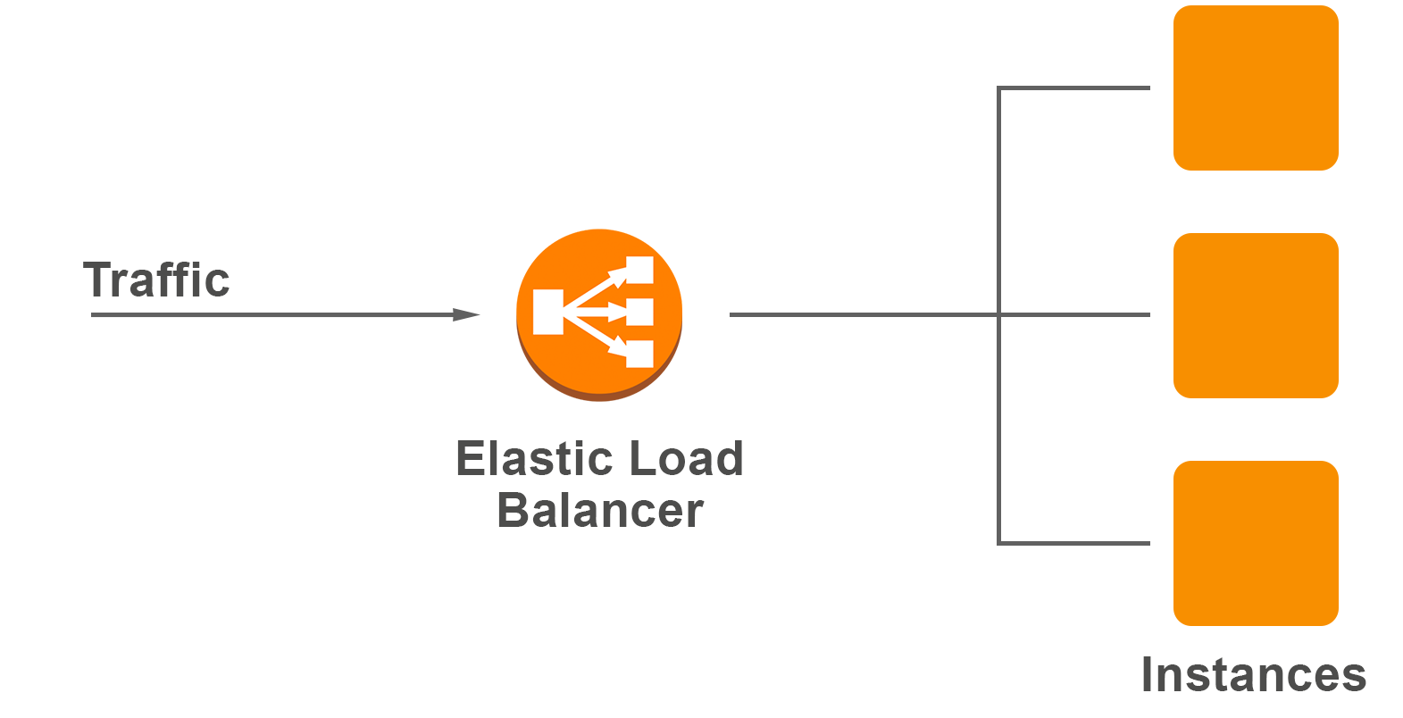
Networking

Slide 22
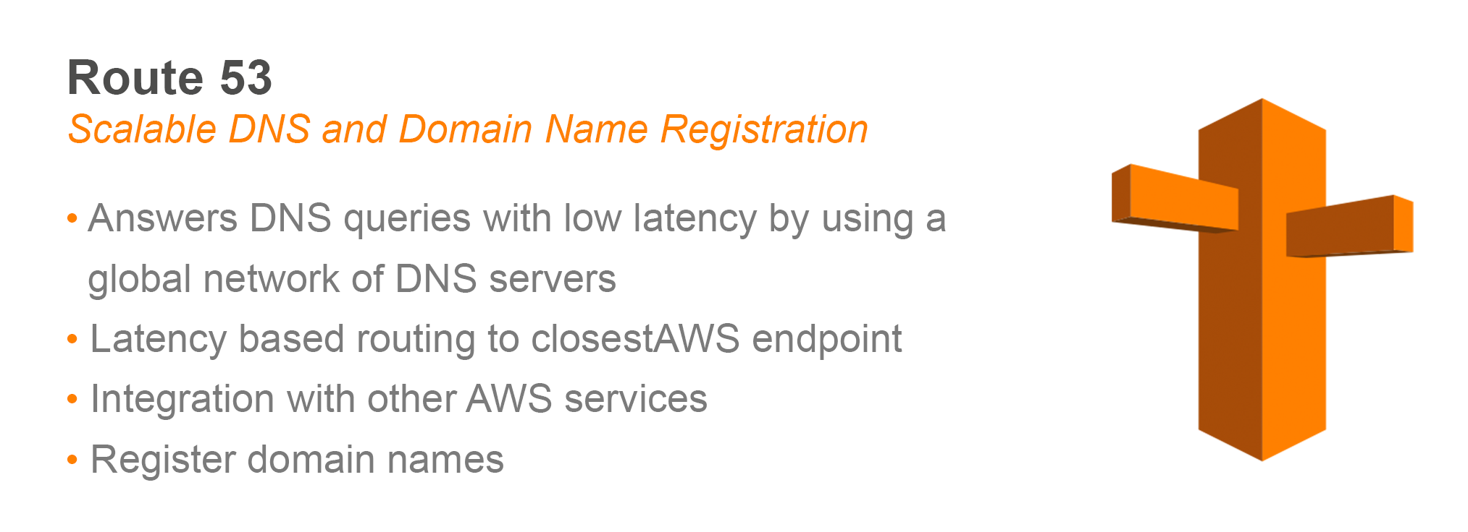
Networking

Slide 23
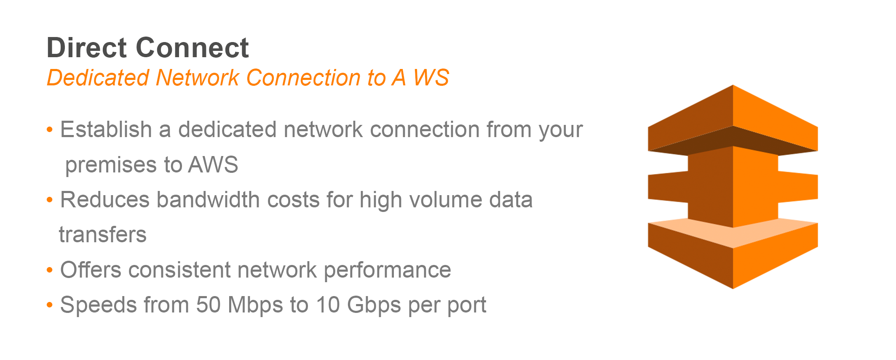
Networking

Slide 24
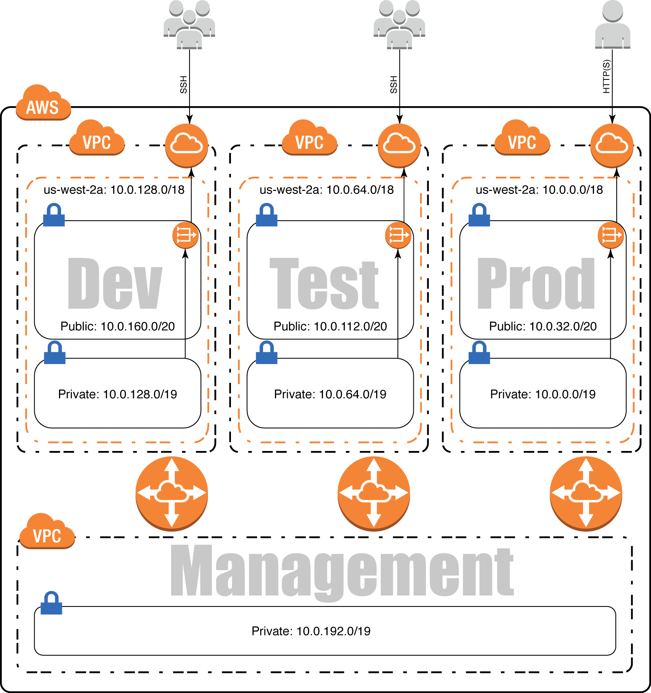
Networking

Slide 25

Application services

Slide 26
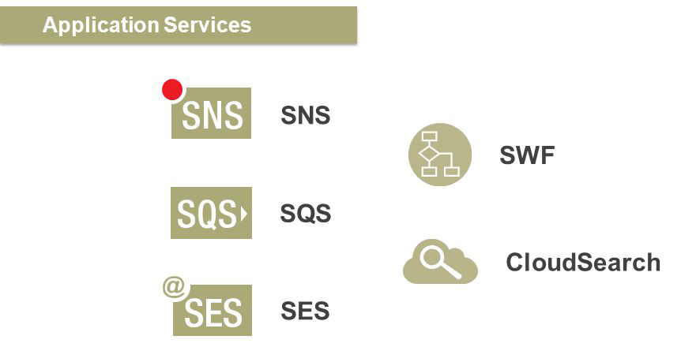
Application services

Slide 27

Logging, administration and security

Slide 28
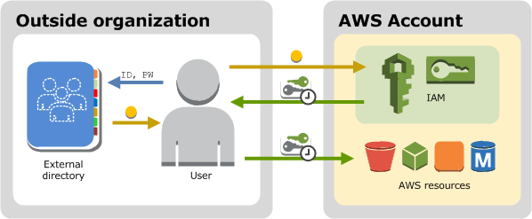
Amazon AIM

Slide 29
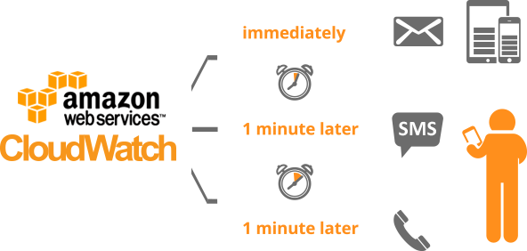
Amazon Cloud Watch

Slide 30
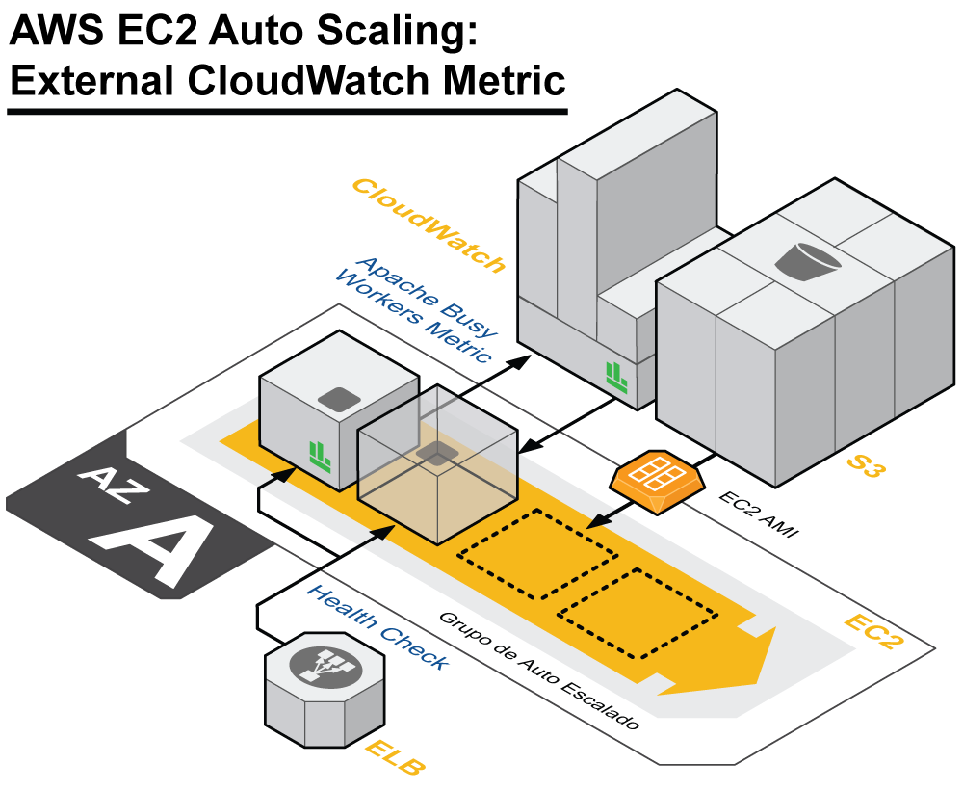
Amazon Cloud Watch

Slide 31

Regions

Slide 32
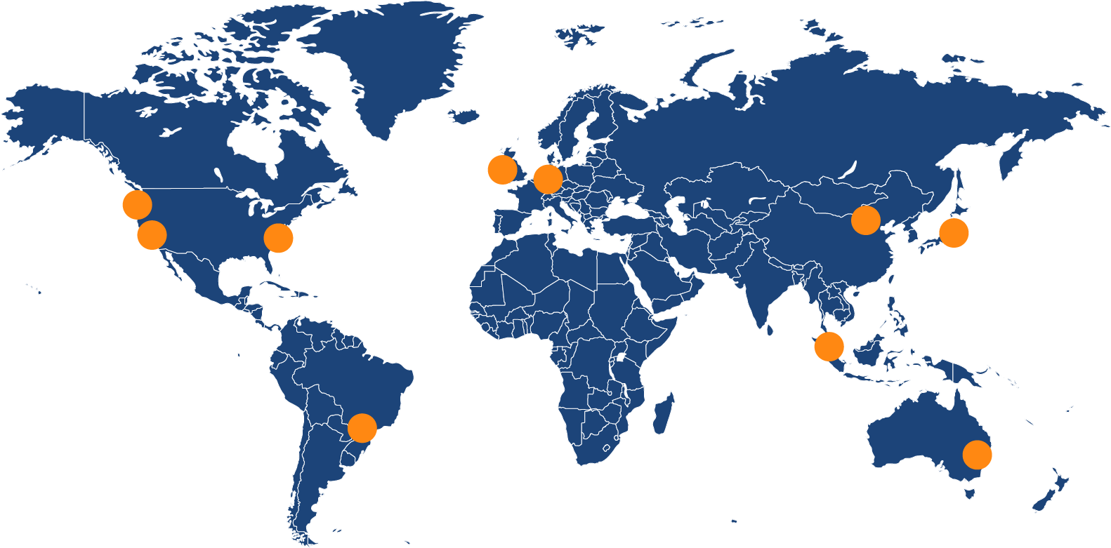
Region

Slide 33
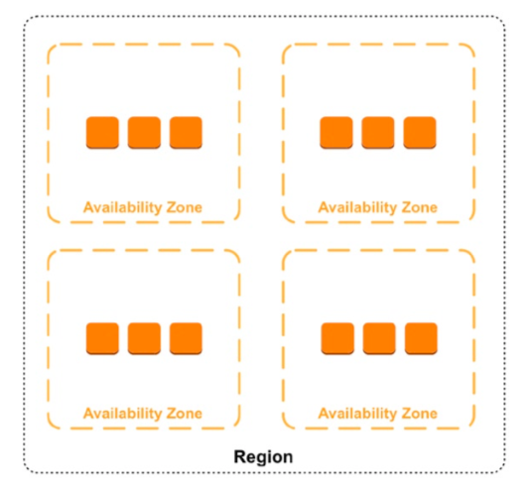
Availability zones

Slide 34

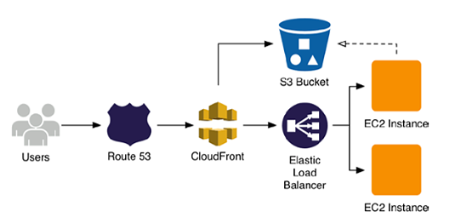

Slide 35

Questions ?

Slide 36

Thanks for attention!

